Slide 1
Protein Structure Prediction:
AB INITIO STRUCTURE PREDICTION
APARNA PATIL KOSE
LECTURER
DEPT OF BIOINFORMATICS

Slide 2
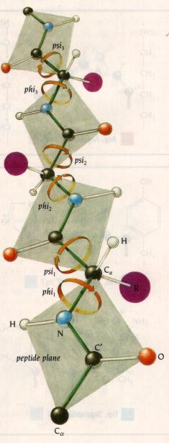
Protein Structure Prediction
A protein structure can be solved computationally
A protein folds into a 3D structure to minimize its free potential energy
The problem can be formulated as a search
problem for minimum energy
the search space is enormous
the number of local minima increases exponentially
Computationally it is an exceedingly difficult problem
2
7/7/2014

Slide 3
Observations
Sequences determine structures
Structures are more conserved than sequences. Two protein with 30% identity likely share the same fold.
3

Slide 4
What determines structures?
Hydrogen bonds: essential in stabilizing the basic secondary structures
Hydrophobic effects: strongest determinants of protein structures
Van der Waal Forces: stabilizing the hydrophobic cores
Electrostatic forces: oppositely charged side chains form salt bridges
4

Slide 5
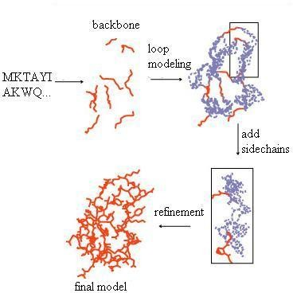
Protein Structure Prediction
Stage 1: Backbone
Prediction
Ab initio folding
Protein threading
Homology
modeling
Stage 2: Loop Modeling
Stage 3: Side-Chain
Packing
Stage 4: Structure Refinement
The picture is adapted from http://www.cs.ucdavis.edu/~koehl/ProModel/fillgap.html
5

Slide 6
Protein Structure Prediction
Ab initio
Threading
Comparative (Homology) modeling
6

Slide 7
Protein Structure Prediction
Ab initio
Threading
Comparative (Homology) modeling
7

Slide 8
State of The Art
Ab initio folding (simulation-based method)
1998 Duan and Kollman
Do not find native structure
Template-based (or knowledge-based) methods
Protein threading: sequence-structure alignment, can go beyond the 25% limit
Homology modeling: sequence-sequence alignment,
works if sequence identity > 25%

Slide 9
Computational Models
A model is a system of equations, or computations used to determine the energetics of a molecule
Different models use different approximations (or levels of theory) to produce results of varying levels of accuracy.
There is a trade off between accuracy and computational time.
There are two main types of models; those that use Schrödinger's equation (or simplifications of it) and those that do not.

Slide 10
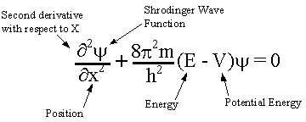
Schrödinger's equation
Physicist Erwin Schrödinger, 1926
Describes changes in quantum state of a physical
system with time
Used to find the allowed energy levels of quantum
mechanical systems (such as atoms).

Slide 11
Wave function
A mathematical function that describes the
full behavior of physical system
In theory: knowing all of the variables associated with the system, one could predict anything about it.

Slide 12
Shows all of the wave like properties of matter
Deal with problems about the atomic structure of matter.
Powerful mathematical tool and the whole basis of
wave mechanics.
Predicts the future behavior of a dynamic system.

Slide 13
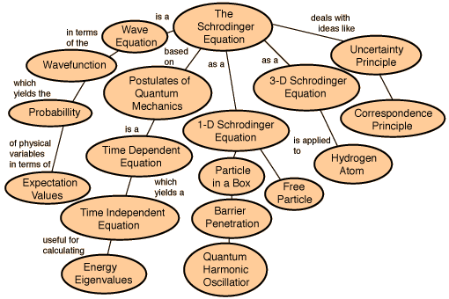

Slide 14
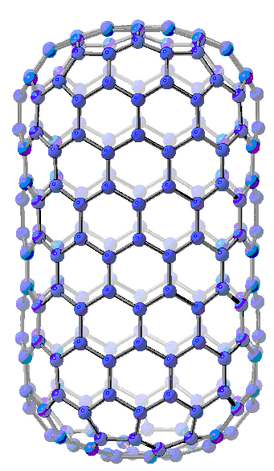
Computational Models
Types of Models
Ab initio
uses Schrodinger's equation, but with approximations
Semi Empirical
uses experimental parameters and extensive simplifications of Schrodinger's equation
Molecular Mechanics
does not use Schrodinger's
equation
Simulated (12,0) zigzag carbon nanotube

Slide 15
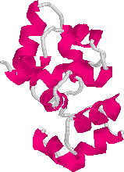
Ab initio
The sequence
M | A | A | G | Y | A | V | L | S
structural model

Slide 16
Ab initio BASICS
Latin term for “from first-principles” or “from scratch”
Template Free Modeling
The only computational chemistry method that is 100% mathematical
Do not use experimental data
Based primarily on Schrodinger's equation.
Used to calculate a wide variety of properties.

Slide 17
Ab initio
Build structures purely from protein sequences
An energy function to describe the protein
bond energy
bond angle energy
dihedral angle energy
van der Waals energy
electrostatic energy
Calculating the structure through minimizing the energy function
Not practical in general
Computationally very expensive
Accuracy is poor

Slide 18
Ab initio
No use of sequence alignments and no direct use of
known structures
The basic idea is to build empirical function that simulates real physical forces and potentials of chemical contacts
If we will have perfect function and we will be able to scan all the possible conformations, then we will be able to detect the correct fold

Slide 19
Ab initio METHODS
Ab initio states that:
If one knows the structure of the molecule, one should be able to perform a complete calculation of that molecule completely from mathematical principles.

Slide 20
Model Chemistry
Complete mathematical description of a particular calculation.
2 components:
Specific theory used
Specific basis set used as starting point HF-SCF Theory

Slide 21
Ab initio METHODS
Different Levels of Ab Initio Calculations
Hartree-Fock (HF)
The simplest ab initio calculation
The major disadvantage of HF calculations is that electron correlation is not taken into consideration.
The Møller-Plesset Perturbation Theory (MP)
Density Functional Theory (DFT)
Configuration Interaction (CI)
Take into consideration electron correlation

Slide 22




Predicting Protein Structure: Ab initio Methods
Sequence
Prediction
Secondary structure
Tertiary structur e
Low energy structures
Validation
Predicted structure
Energy
Minimization
Mean field potentials

Slide 23
Ab initio Methods
Simplified models
simplified alphabet
simplified representation (lattice) Build-up techniques
Deterministic methods quantum mechanics diffusion equations
Stochastic searches Monte Carlo genetic algorithms

Slide 24
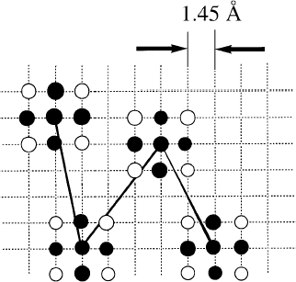
Lattice Model
The model chain consists of a string of virtual bonds connecting the interaction centers that correspond to the center of mass of the side chains and the backbone alpha carbons.
These interaction centers are projected onto an underlying cubic lattice with a lattice spacing of 1.45 A°
A cluster of excluded volume points is associated with each bead of
the model chain.
Each cluster consists of 19 lattice points
Closest approach distance from another cluster labels smallest inter- residue distance

Slide 25
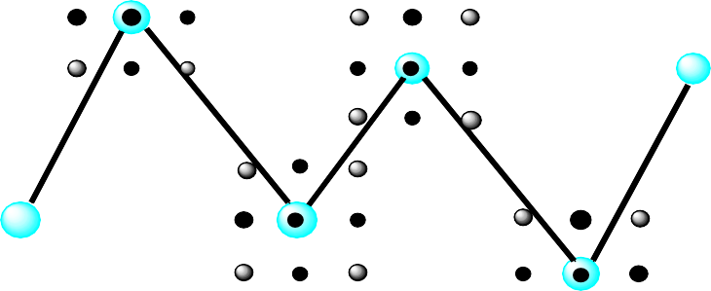
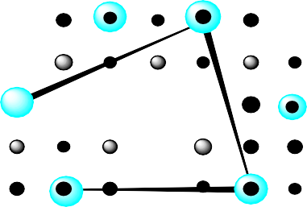

Lattice Model
A simplified representation of proteins
Arrange atoms at grid points by Monte Carlo simulation
NMR restraints can speed up simulation
1.45 A
Taken from Jeff. Skolnick et al.

Slide 26
Density Functional Theory
Considered an ab initio method, but different from other ab initio methods because the wave function is not used to describe a molecule, instead the electron density is used.
Three types of DFT calculations exist:
Local density approximation (LDA) – fastest method, gives
less accurate geometry, but provides good band structures
Gradient corrected - gives more accurate geometries
Hybrids (which are a combination of DFT and HF methods) - give more accurate geometries

Slide 27
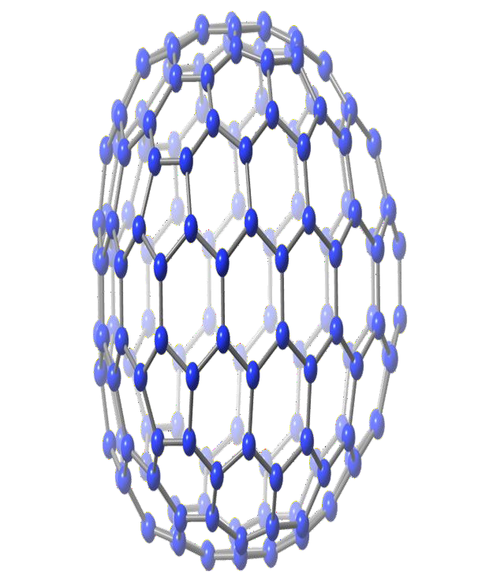
DFT
These types of calculations
are fast becoming the most relied upon calculations for
nanotube and fullerene systems.
DFT methods take less computational time than HF calculations and are considered more accurate
This (15,0) short zigzag carbon nanotube was simulated with two different models: Hartree-Fock and DFT. The differences in energetics are shown in the table.
DFT: -6139.46 |  | HF: -6132.89
% Difference: 0.11% (units: a.u.)

Slide 28
Semi Empirical
Semi empirical methods use experimental data to parameterize equations
Like the ab initio methods, a Hamiltonian and wave function are used
much of the equation is approximated or eliminated
Less accurate than ab initio methods but also much
faster
The equations are parameterized to reproduce specific results, usually the geometry and heat of formation, but these methods can be used to find other data.

Slide 29
Typical shortcuts for Structure Prediction:
Reduce conformational space
1,2 atoms per residue
fixed lattices
Statistic force-fields obtained from known structures
Average distances between residues
Interactions
Use building blocks: 3-9 residues from PDB structures

Slide 30
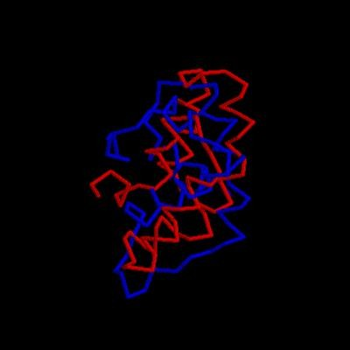




Ab-initio Drawbacks
Average error 5 Å - 10 Å
Function cannot be predicted
Long simulations
Some protein from E.coli predicted at 7.6 Å (CASP3, H.Scheraga)

Slide 31
Applications of MM in Ab Initio
Basic idea
Anfinsen’s theory: Protein native structure corresponds to the state with the lowest free energy of the protein-solvent system.
General procedures
Potential function
Evaluate the energy of protein conformation
Select native structure
Conformational search algorithm
To produce new conformations
Search the potential energy surface and locate the global
minimum (native conformation)

Slide 32
Importance
The ab initio methods are important even though they are computationally demanding
Ab initio methods predict protein structure based on physical models, they are indispensable complementary methods to Knowledge-based approach
Eg.
Knowledge-based approach would fail in following conditions:
Structure homologues are not available
Possible undiscovered new fold exists

Slide 33
ROSETTA
One of the most successful ab initio strategies.
A web server which predicts protein three- dimensional conformations using the ab initio method.
Target protein evaluated into fragments (of 9 a.a; mini
threading); compared to known structures in PDB.
Model Accuracies of 3- 6 A° RMSD.
Bonneau et. al. (2002) used Rosetta to model structure of all Pfam-A sequence families for which 3D structures are unknown.

Slide 34
Rosetta approach
Rosetta (David Baker) consistently outstanding performer in last two CASPs
Integrated method
I-Sites: much finer grained substructures than secondary structures. A library of all structures each AA 9mer is found in (taken from PDB)
Heuristic global energy function to estimate quality of folds
Monte Carlo search through assignments of I-Sites to minimize energy function.
Also, HMMSTR, HMM-driven method for assigning I-
Sites.

Slide 35
Rosetta prediction method
Define global scoring function that probability of a structure given a sequence
estimates
Generate version of I-sites with fixed length sub- sequences (9 amino acids)
Calculate P(I-Site/sequence) for all sequences and I-
sites
Generate structures by Monte Carlo sampling of assignments of fixed size I-sites to sub-sequences
End up with ensemble of plausible structures

Slide 36
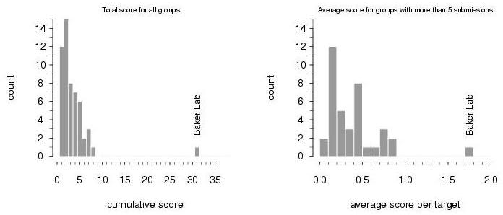
Rosetta is way ahead
CASP 4 results.
CASP 5 similar, but not as dramatic.

Slide 37
CASP
Critical Assessment of Techniques for Protein Structure Prediction
Provide independent, unbiased or blind assessment (competition) of different programs or methods.
Checks reliability of the prediction methods.

Slide 38


CASP/CAFASP
CASP: Critical Assessment of Structure Prediction
CASP
Predictor
CAFASP: Critical Assessment of Fully Automated Structure Prediction
CAFASP
Predictor
Won’t get tired
High-throughput

Slide 39
CASP/CAFASP (cont’d)
Public
Organized by structure community
Evaluated by the unbiased third-party
Held every two years
Blind
Experimental structures to be determined by structure
centers after competition
Drawback: <100 targets
Blindness
Some centers are reluctant to release their structures

Slide 40
CAFASP/CASP (cont’d)
Time for each target
Individual Servers: 48 hours
Meta Servers: 96 hours
CASP5 Predictors: 3 to 4 months
Resources for predictors
No X-ray, NMR machines (of course)
CAFASP3 predictors: no manual intervention
CASP5 predictors: anything (servers, google,…)
Evaluation
CASP5 assessed by experts + computer
CAFASP3 evaluated by a computer program.

Slide 41
Reading List
CASP1, CASP2, CASP3, CASP4, CASP5 and CASP6 Special Issues, Proteins: Structure, Function and Genetics, 1995, 1997, 1999, 2001, 2003, 2005
Jinbo Xu. Rapid Protein Side-Chain Packing via Tree Decomposition. RECOMB 2005.

